Slide 1

School of Technology, Design and
Computer Application
Silver Oak College of Engineering and Technology
Bachelor of Technology
Department of Information Technology
Movie Sentiment Analysis
Devangi Kachhadiya
2201031030016
Guide
Prof. Kruti Ma’am

Slide 2
Table of Content
Abstract
Introduction
Objectives
Literature Survey
Tools and Technology Used
Timeline chart
Implementation
Future Work
Conclusion
References

Slide 3
Abstract
The Movie Sentiment Analysis project focuses on analyzing movie reviews to determine whether they are positive or negative. Using machine learning and Natural Language Processing (NLP) techniques, the system processes large amounts of review data to identify the overall sentiment of viewers. This helps provide insights into how audiences feel about movies, making it useful for filmmakers and moviegoers alike. The project uses models like Naive Bayes and SVM to classify the reviews and visualize the results effectively.

Slide 4
Introduction
In today's digital age, user-generated content like movie reviews plays a crucial role in shaping public opinion and influencing audience decisions. With the vast amount of reviews available online, understanding the overall sentiment of these reviews can provide valuable insights for filmmakers, critics, and movie enthusiasts.
The Movie Sentiment Analysis project aims to analyze these reviews to determine whether they express positive or negative sentiments. Using NLP techniques and machine learning models such as Naive Bayes and SVM, the system processes large datasets to accurately classify the sentiment. This project not only helps in summarizing audience feedback but also demonstrates the growing impact of AI in understanding human emotions through text.

Slide 5
Objectives
Understand Audience Opinions: Helps identify viewer sentiment (positive, negative, neutral) from reviews.
Guide Filmmakers: Provides insights for improving future projects and marketing strategies.
Save Time: Automates analysis of large volumes of user-generated content.
Support Decision-Making: Assists viewers in choosing movies aligned with their preferences.
Business Benefits: Offers insights for targeting audiences and personalizing recommendations.

Slide 6
Literature Survey
Sentiment Analysis: Early works by Pang and Lee (2002) applied machine learning algorithms like Naive Bayes and SVM for movie review sentiment classification. Sentiment analysis helps interpret opinions and emotions in text.
Text Preprocessing: Techniques like tokenization, stemming, and stopword removal improve text data quality for analysis. Porter (1980) introduced widely used stemming algorithms.

Slide 7
Literature Survey
3. Naive Bayes: McCallum and Nigam (1998) showed that the Multinomial Naive Bayes model performs well for text classification, especially for sentiment analysis.
4. Advanced Models: Recent advances like BERT (Devlin et al., 2019) and LSTM provide more accurate sentiment analysis by understanding context in text.
Conclusion:
Sentiment analysis has evolved from simple Naive Bayes models to advanced deep learning approaches. Preprocessing, feature engineering, and contextual understanding are key to improving model performance.

Slide 8
Tools & Technologies used
Python
NLP Libraries:
NLTK and spaCy for text preprocessing (tokenization, stemming, etc.).
Machine Learning Libraries
scikit-learn for Naive Bayes and SVM algorithms.
TensorFlow/Keras for deep learning models if needed.
Data Preprocessing
Pandas and NumPy for data manipulation
Data Visualization
Matplotlib and Seaborn for static graphs.
IDE: Jupyter Notebook

Slide 9
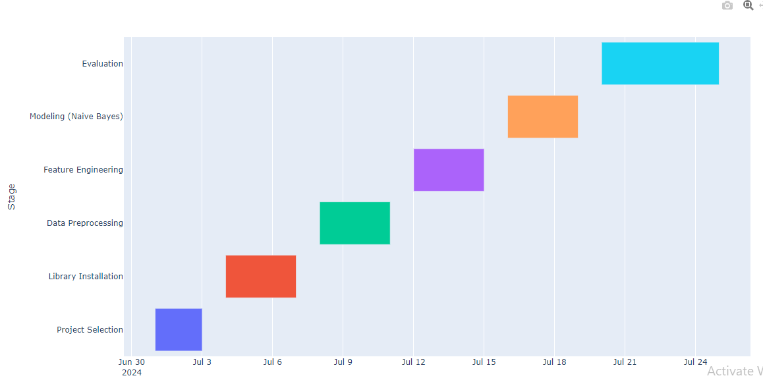
Timeline Chart(Gantt chart)

Slide 10
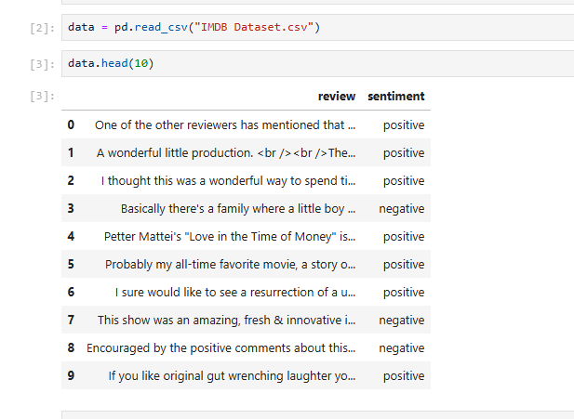
Implementation

Slide 11
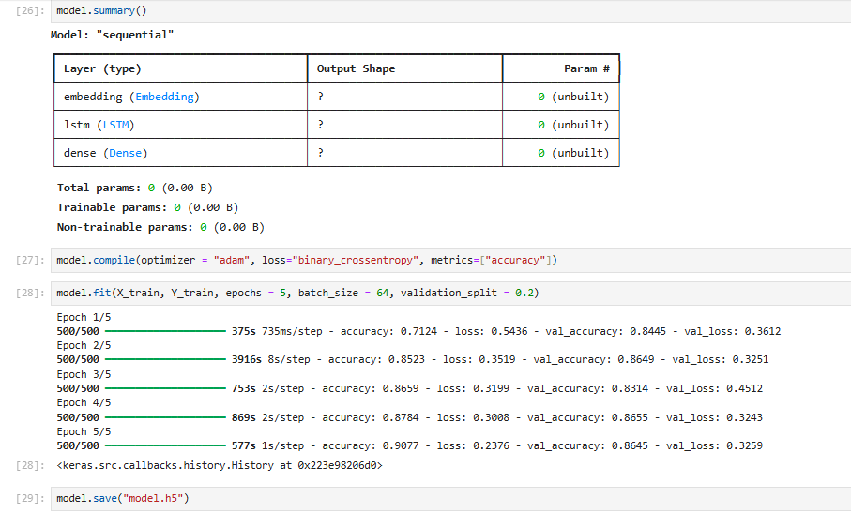
Implementation

Slide 12
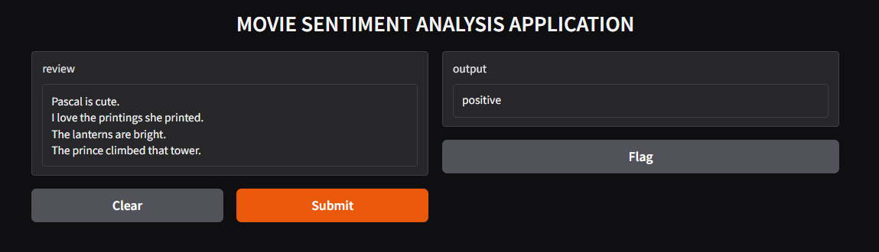
Implementation

Slide 13
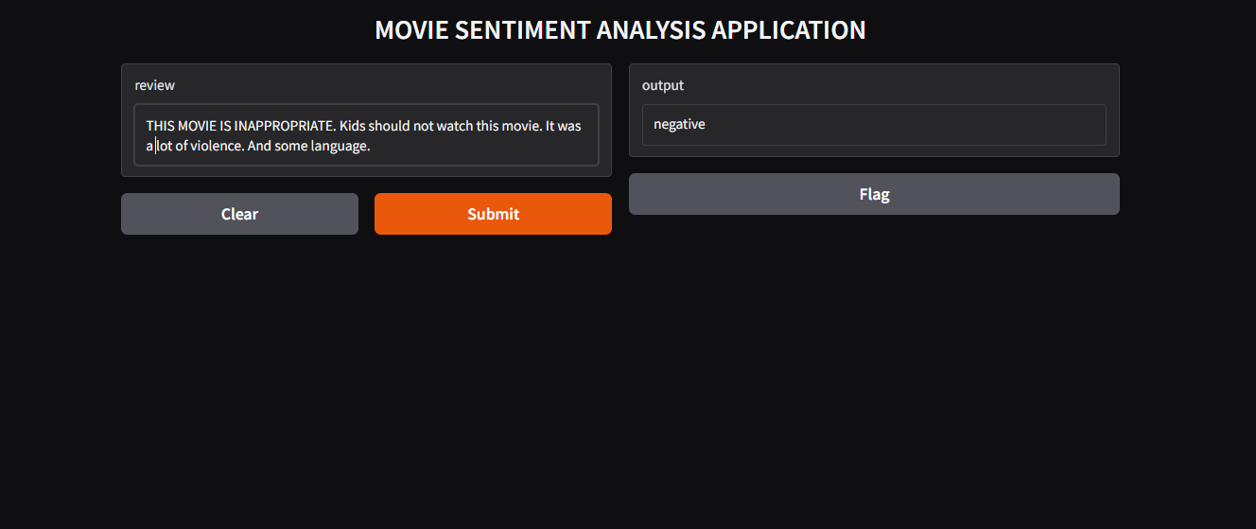
Implementation

Slide 14
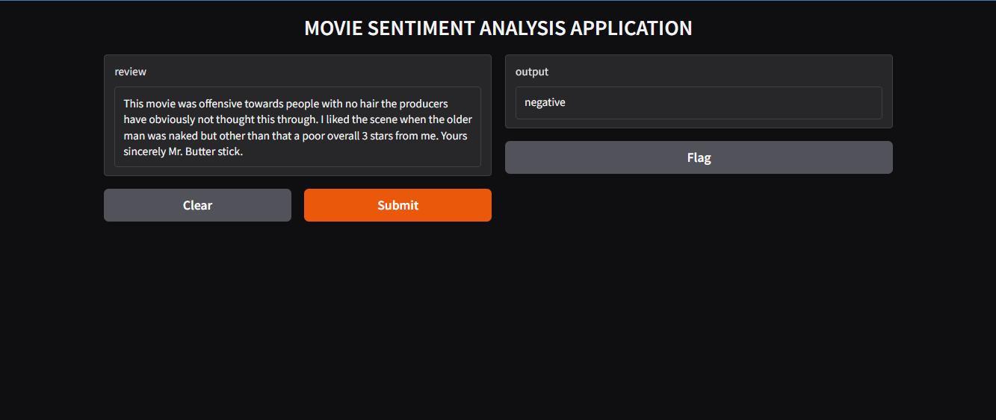
Implementation

Slide 15
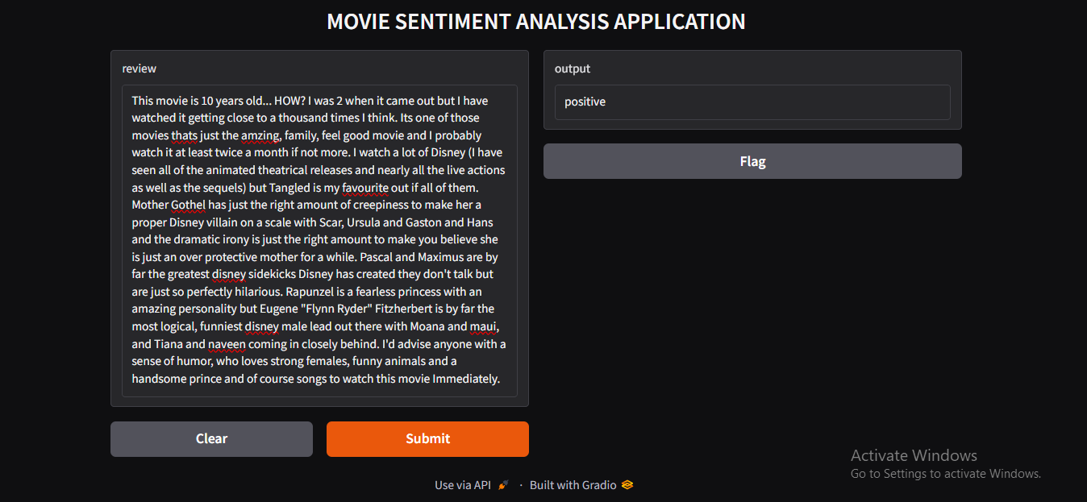
Implementation

Slide 16
Future Work
Model Optimization: Tune hyperparameters and explore advanced algorithms like deep learning.
Granular Classification: Expand sentiment categories (e.g., Neutral, very positive, slightly negative).
Address Data Imbalance: Use techniques like SMOTE for balanced training.
Advanced Features: Implement TF-IDF, word embeddings, or context-based analysis.
Real-Time Deployment: Deploy the model for live sentiment predictions.

Slide 17
Conclusion
The project successfully developed a Naive Bayes-based sentiment analysis model for movie reviews. While initial results are promising, improvements in model accuracy and feature engineering can enhance performance. Future optimizations will make the sentiment analysis more effective and versatile.

Slide 18
References
https://www.itmconferences.org/articles/itmconf/pdf/2023/03/itmconf_icdsia2023_02006.pdf
https://www.kaggle.com/datasets

Slide 19
Thank You..!

